Slide 1


MarcEdit Step by Step: Make Bad Records Better For Your Catalog
Kate Wantuch, Systems & Metadata Librarian
3/5/2019

Slide 2

MarcEdit
Creator – Terry Reese, Head of Digital Initiatives at The Ohio State University Libraries
Began 1999 for a major database cleanup project at Oregon State University
Terry moved to Ohio State in 2013
MarcEdit is Free!

Slide 3
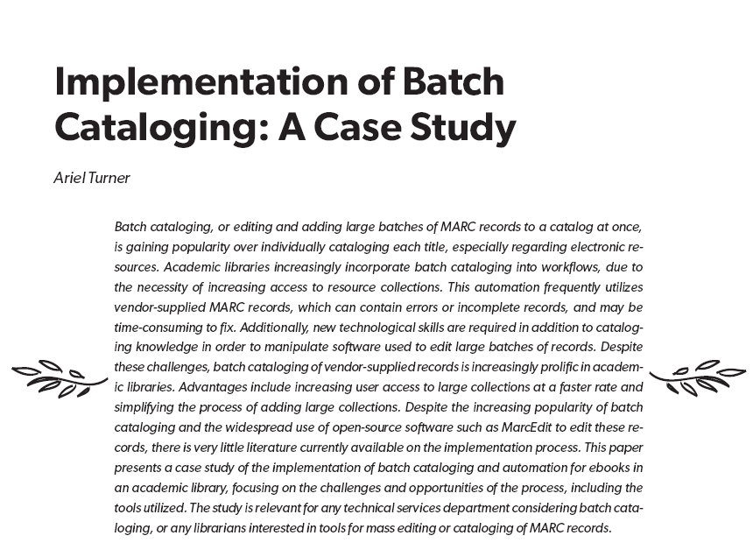
http://www.ala.org/acrl/sites/ala.org.acrl/files/content/conferences/confsandpreconfs/2015/Turner.pdf
Notes:
ACRL 2015 Proceedings

Slide 4
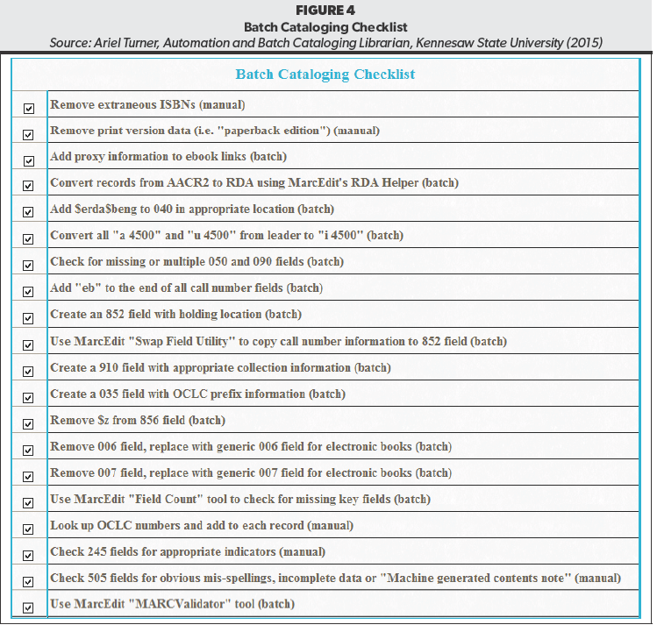
Batch Cataloging Checklist

Slide 5
Kate’s Files
https://github.com/WanAndy/MarcEditStuff
https://github.com/WanAndy/MarcEditStuff

Slide 6
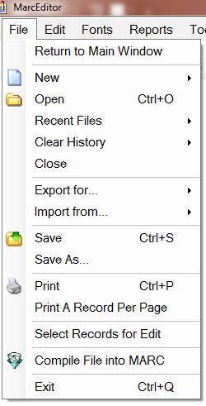

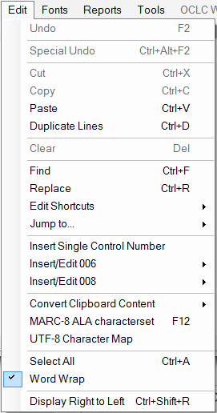

Text editor with similarities to MS Office products and others

Slide 7
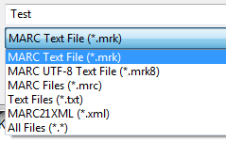
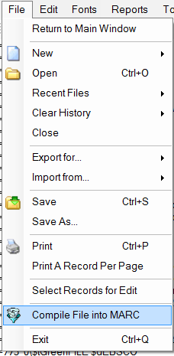
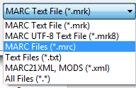
.MRK versus .MRC
MarcEdit default is .mrk so to open a .mrc use
File->Open->.mrc
Save often as .mrk
Finally compile and save as .mrc

Slide 8
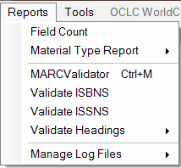
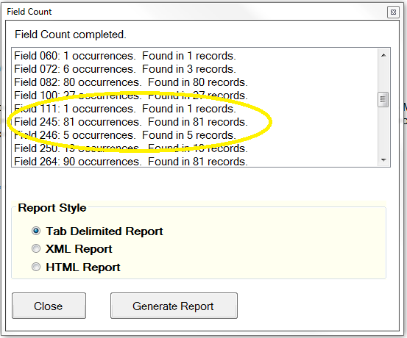
Reports – Field Count

Slide 9
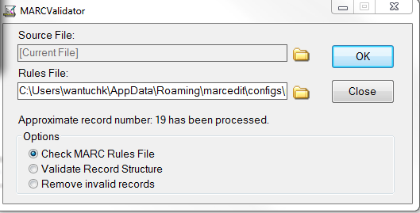
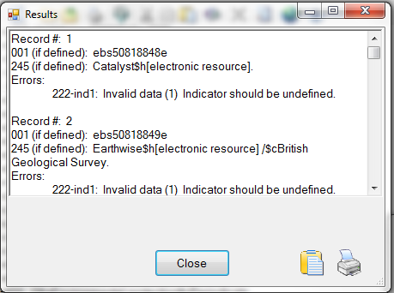
Reports – MARCValidator

Slide 10

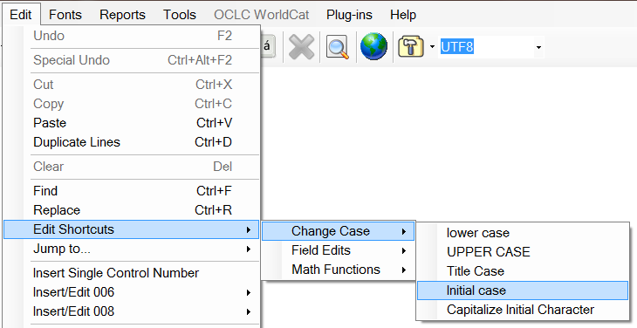
Check 245 title for appropriate case
Step 1:

Slide 11
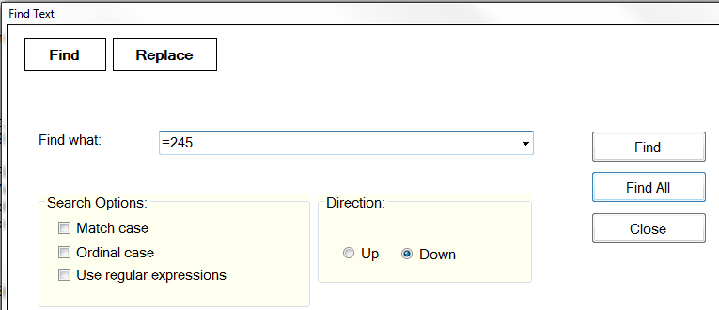
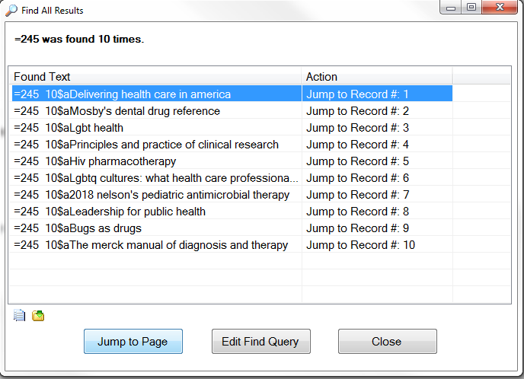
Check 245 Title for appropriate case
Step 2: Find->Replace

Slide 12
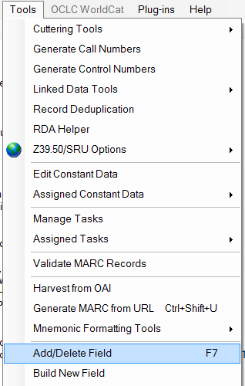
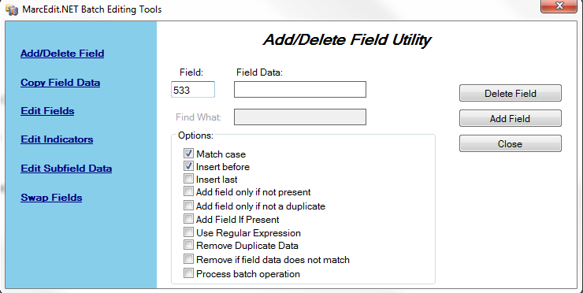
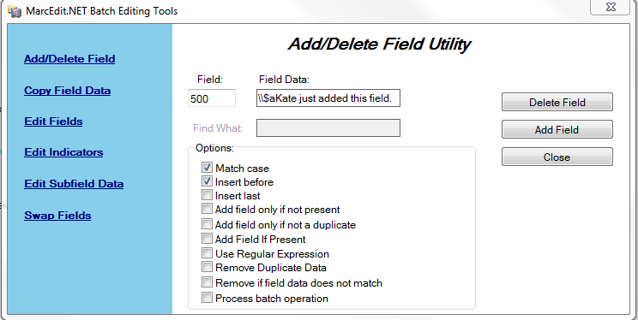
Add/Delete Fields
Remember your indicators!
????

Slide 13
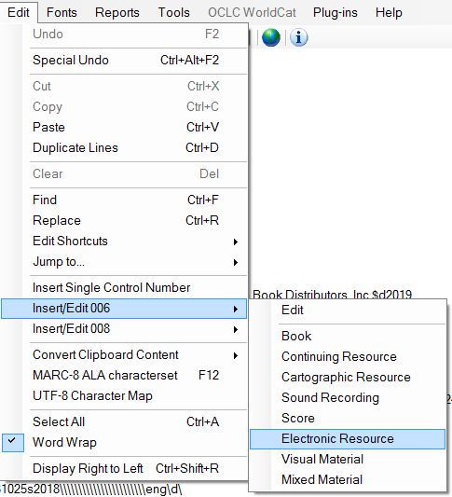
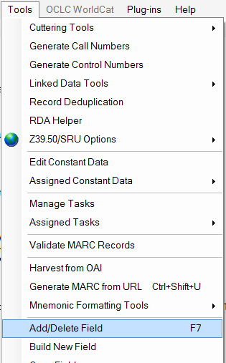
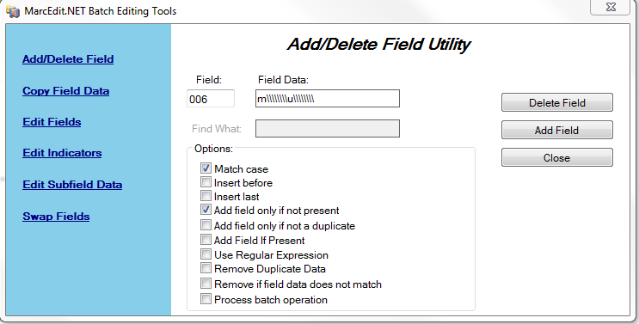
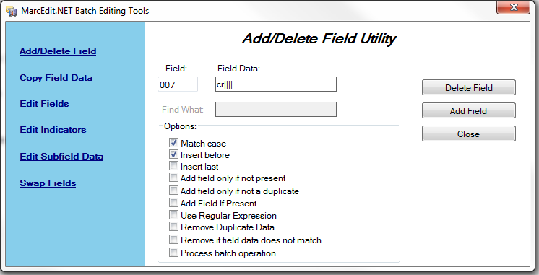
Making a Print Record an Online Record
006
Cut
m\\\\\\\\u\\\\\\\\
007
cr||||

Slide 14
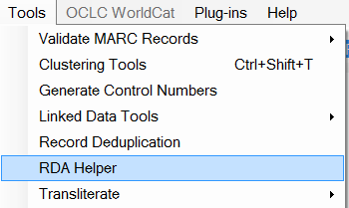
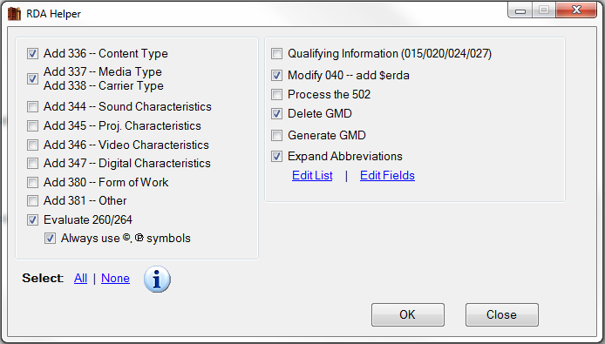
Convert to RDA

Slide 15
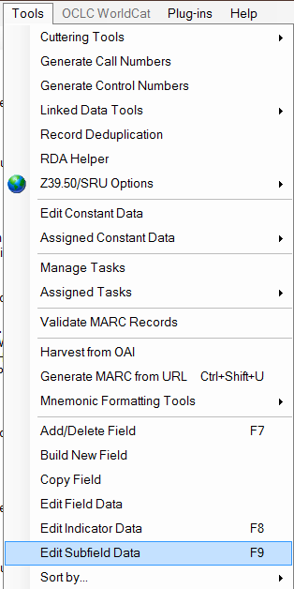
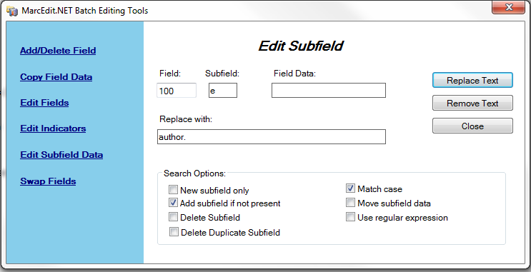
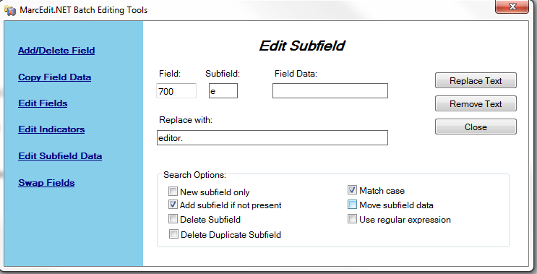
Convert to RDA Adding Relator Field $e

Slide 16
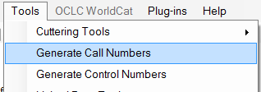
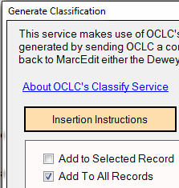
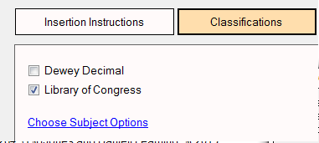
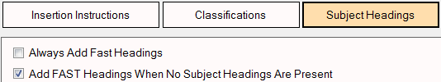
Add 650 Subject Headings
Add Call Numbers

Slide 17
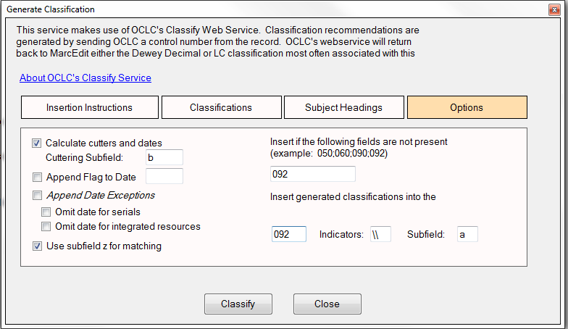
Add 650 Subject Headings
Add Call Numbers

Slide 18
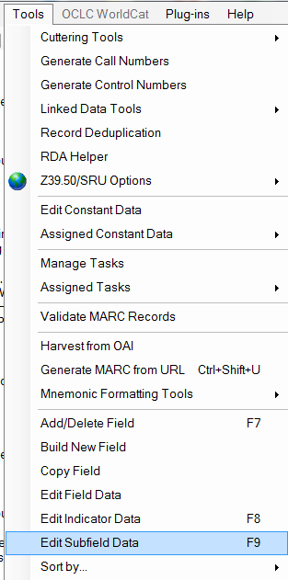
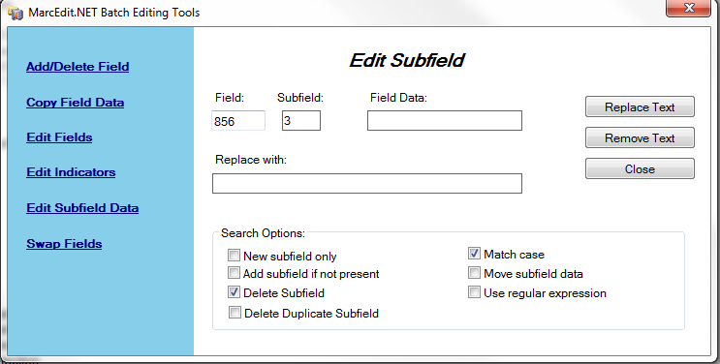
856 URL Field Work Deleting Subfields

Slide 19
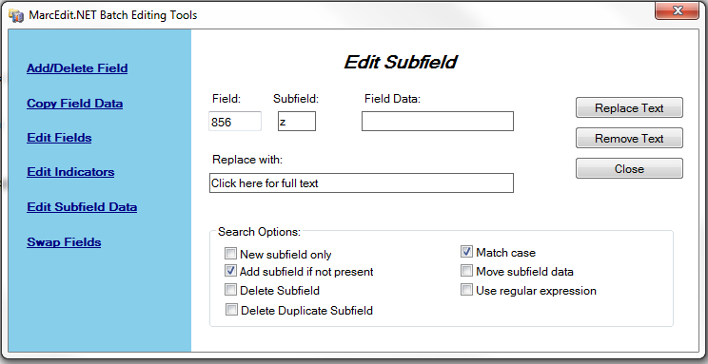
856 URL Field Work Adding $z

Slide 20
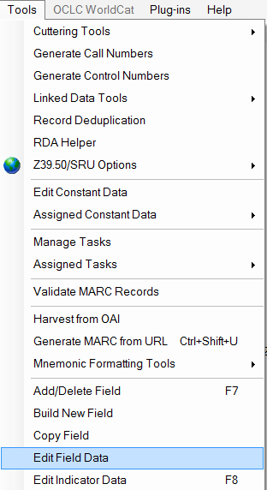
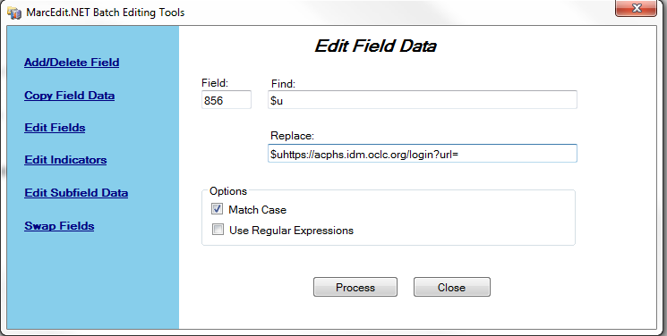
856 URL Field Work Adding proxy URL prefix

Slide 21
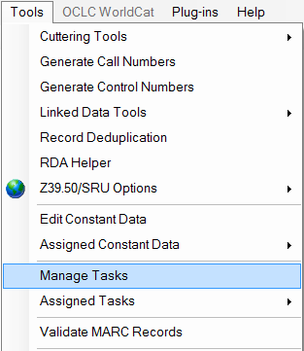
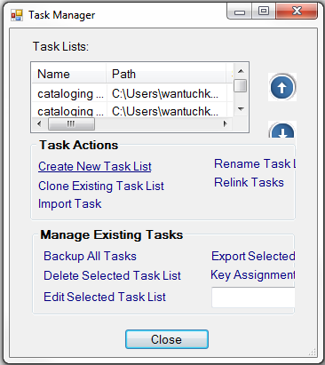
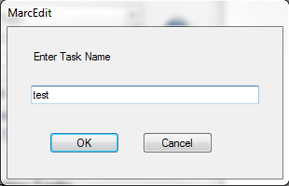
Creating a task list
1
2
3

Slide 22
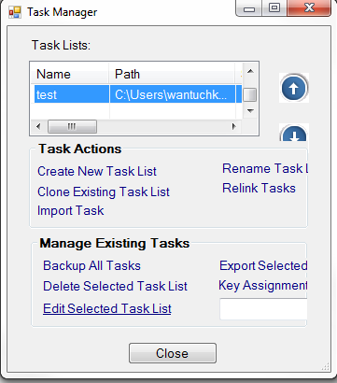
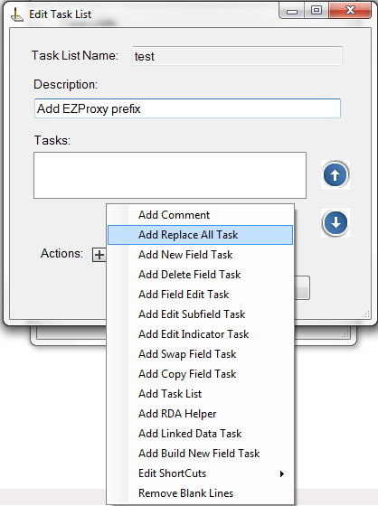
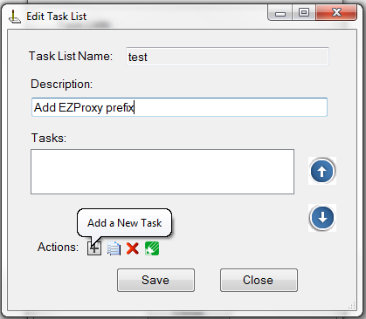
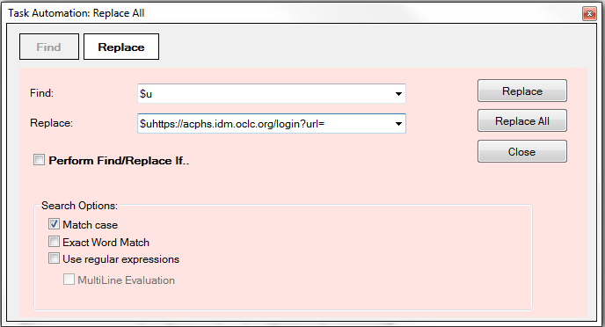
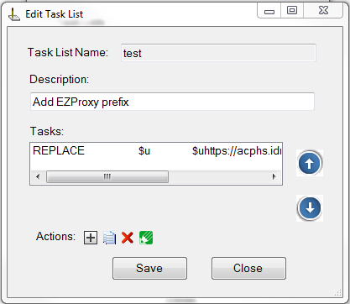
Creating a task list
4
6
5
7
8

Slide 23
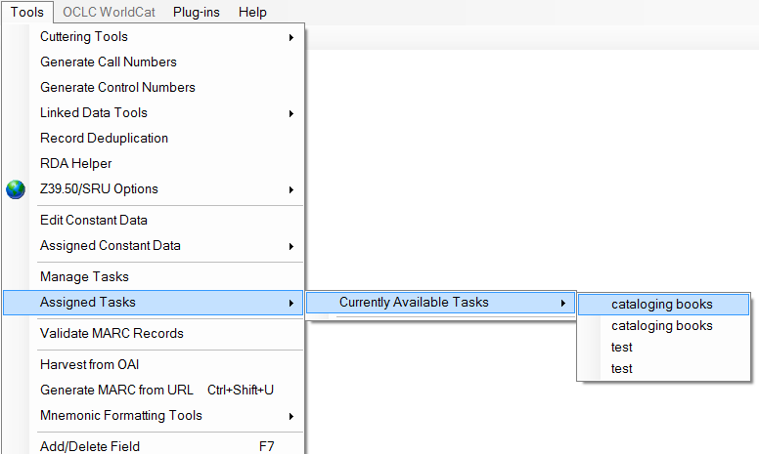
Using a task list

Slide 24
Thank you! Kate.Wantuch@acphs.edu 518-694-7891

